Slide 1
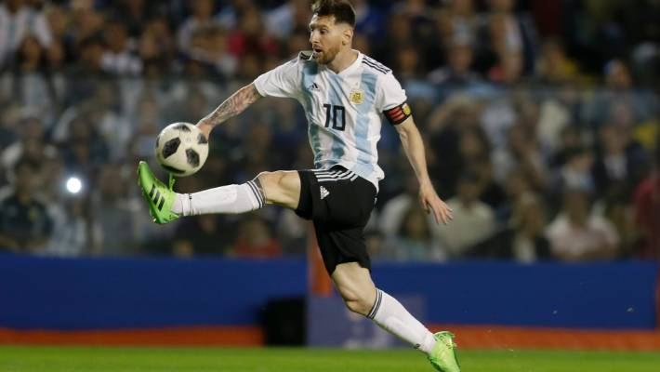
Multivariate Analysis
FIFA
FIFA STARS
MADHU
NISHA
SARANYA
ARJUNA

Slide 2


Player selection PROCESS
MOTIVATION
DATASET
VISUALIZATION
DIMENSION REDUCTION ANALYSIS
CLUSTER ANALYSIS
COFIRMATORY FACTOR ANALYSIS

Slide 3
Motivation
Soccer is an interesting game and it has multiple attributes of the players (dimensions) to perform Multivariate Analysis, to identify clusters from management (money, profitable player) and coach(performance) perspective.

Slide 4
Dataset
Name: FIFA 2019 dataset
Attributes:
ID, Name, Nationality, Club, Position, Preferred Foot, Value, Wage, Age, International Reputation, Crossing, Heading Accuracy, Dribbling, Long Passing, Ball Control, Agility, Stamina, Interceptions, Penalties, Overall.
Dataset columns = 21
Dataset rows = 18,206
Source= Kaggle

Slide 5






Data Cleaning
Data Cleaning:
Dropped 68 columns
Duplicates
Subset data based on overall performance and age.
Sort the top 4c ountries based on number of players
Value conversion
(Million-M
Thousand-K)
Handling Missing values- median
Convert data to matrix and scale
For example, balance variable also measures an ball control variable.

Slide 6
Data Visualization
Scatterplot matrix
Line Plot
Visualize Missing Values
Bivariate Plot

Slide 7
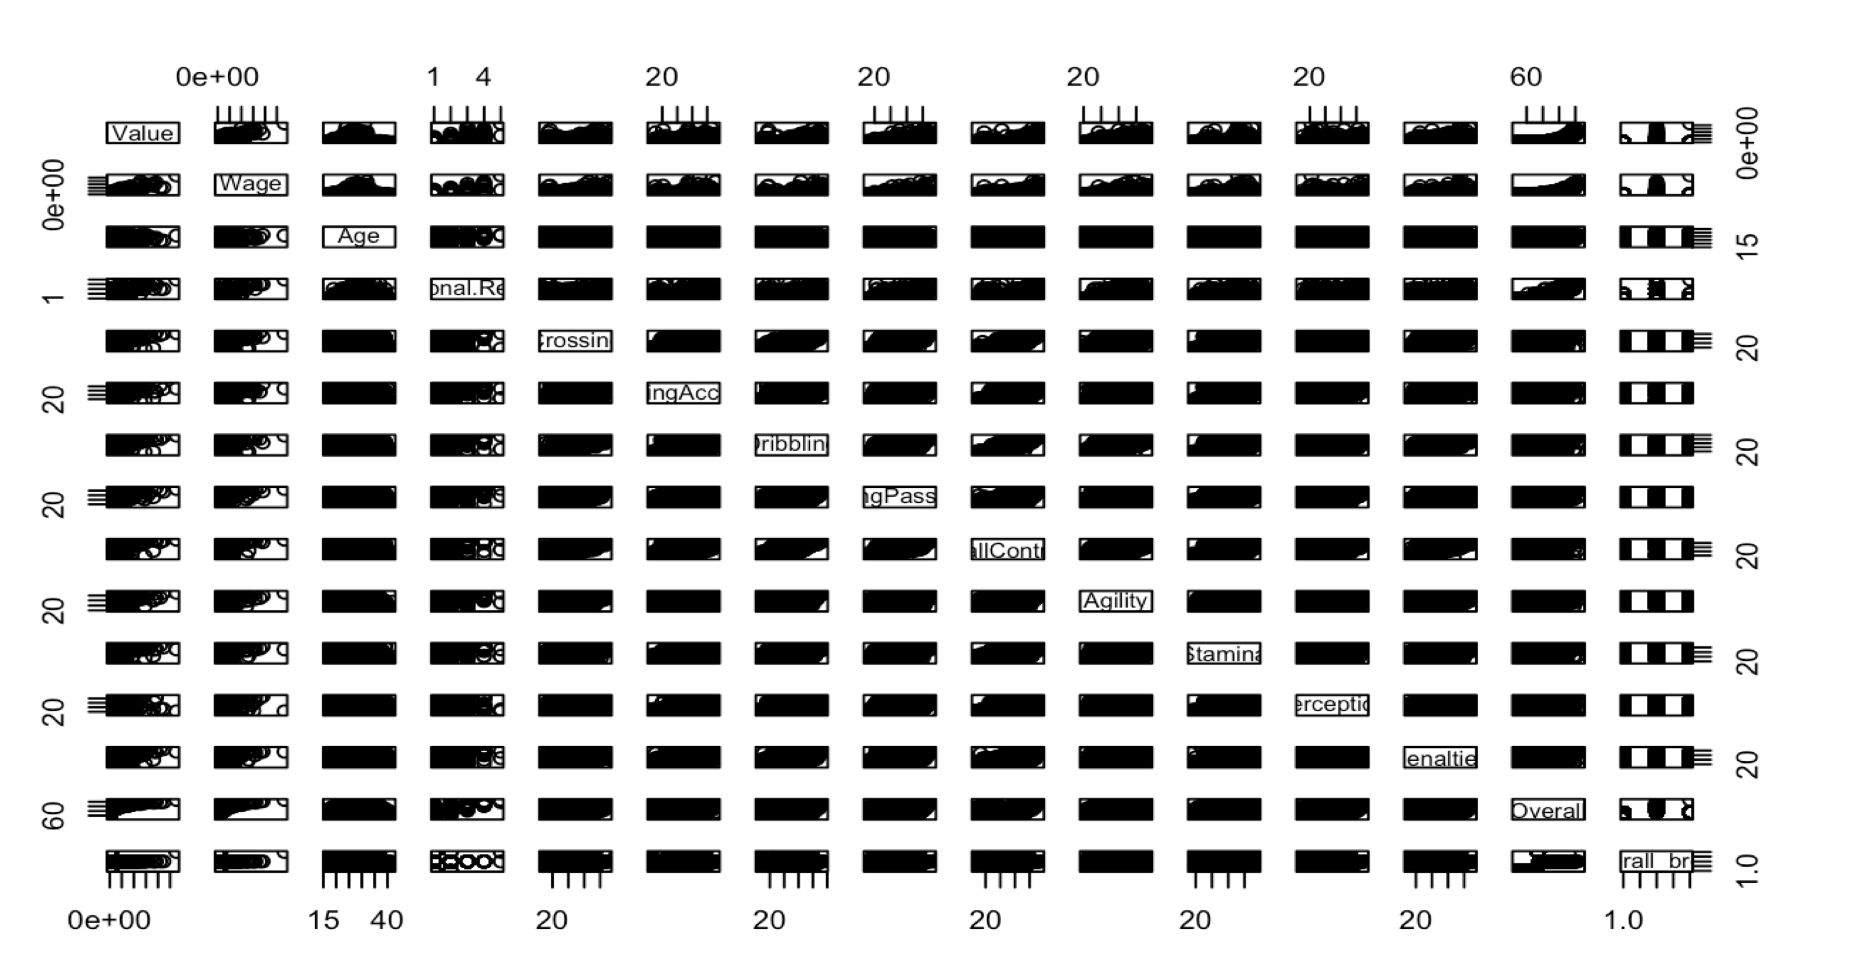
Scatter Plot Matrix

Slide 8
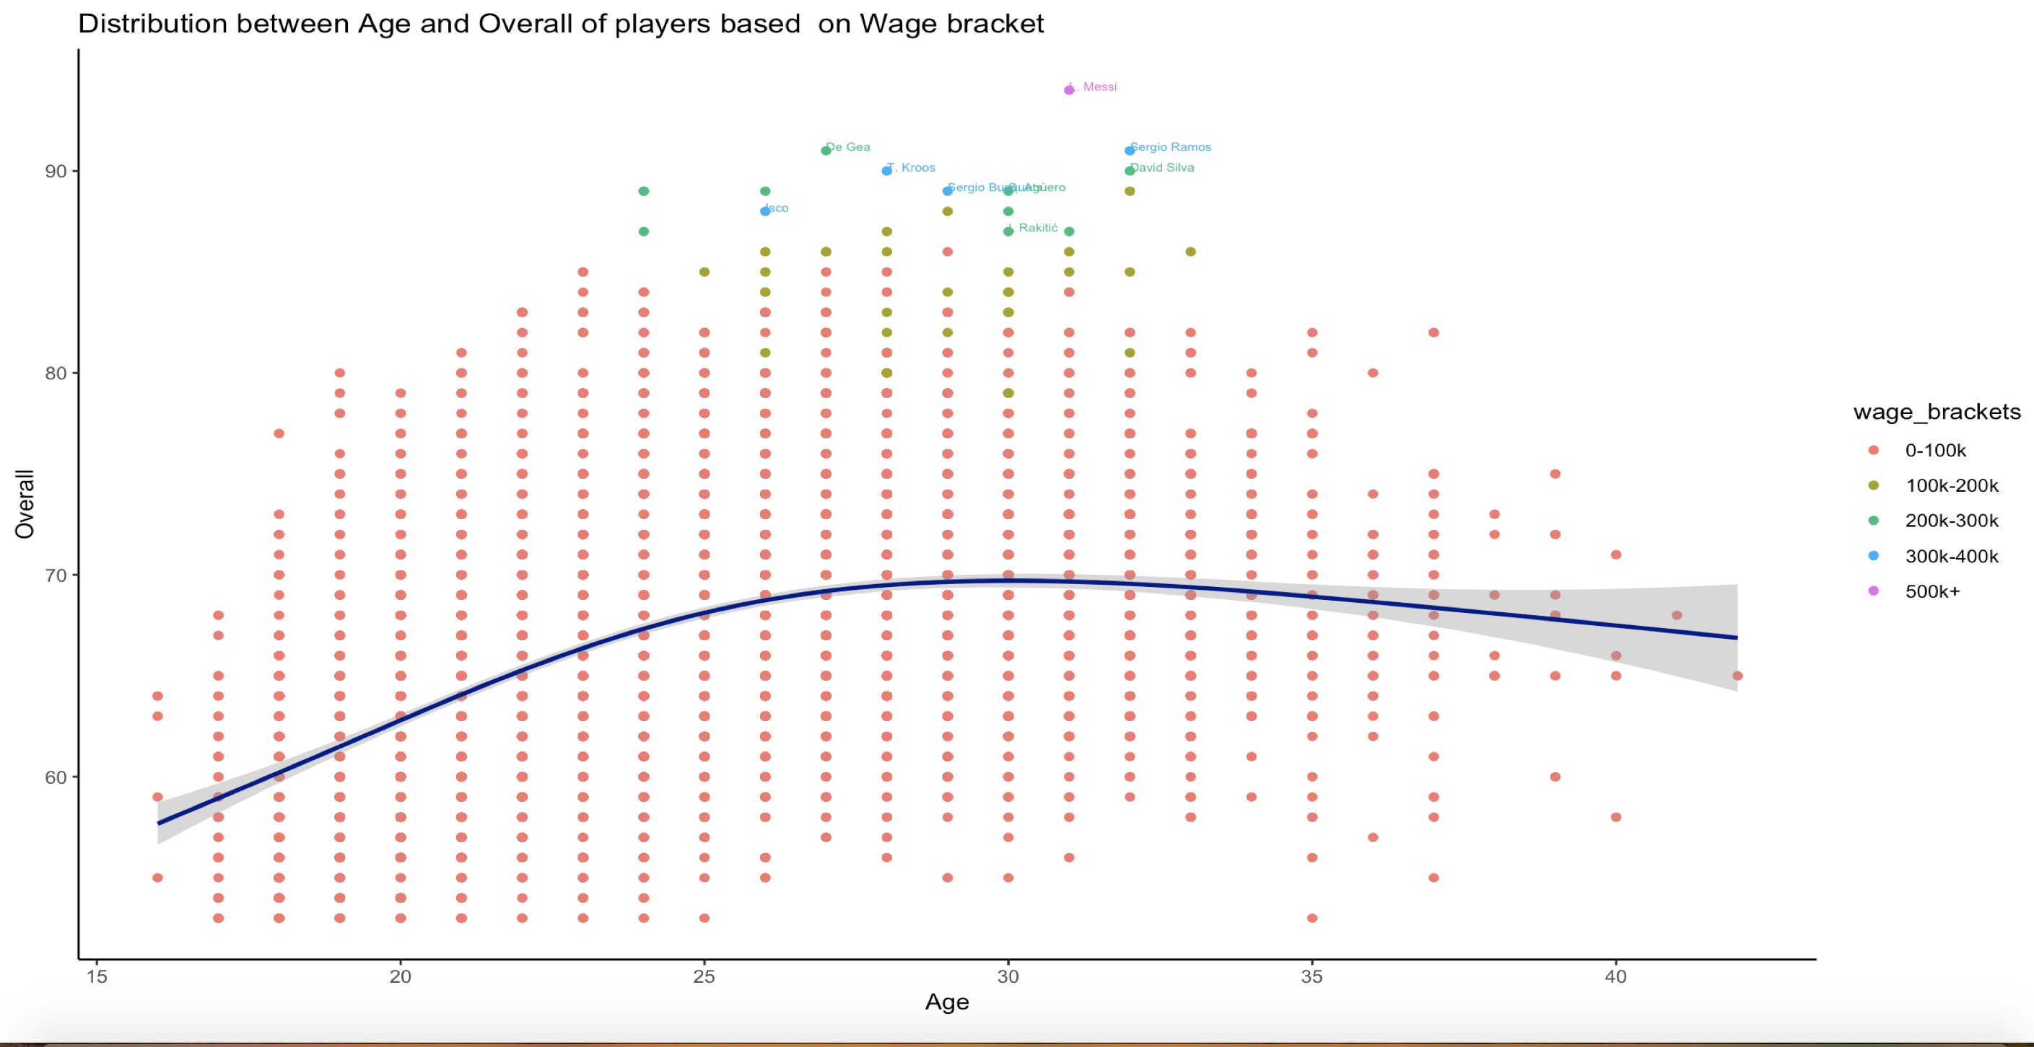
Overall Performance vs Age –Line plot

Slide 9
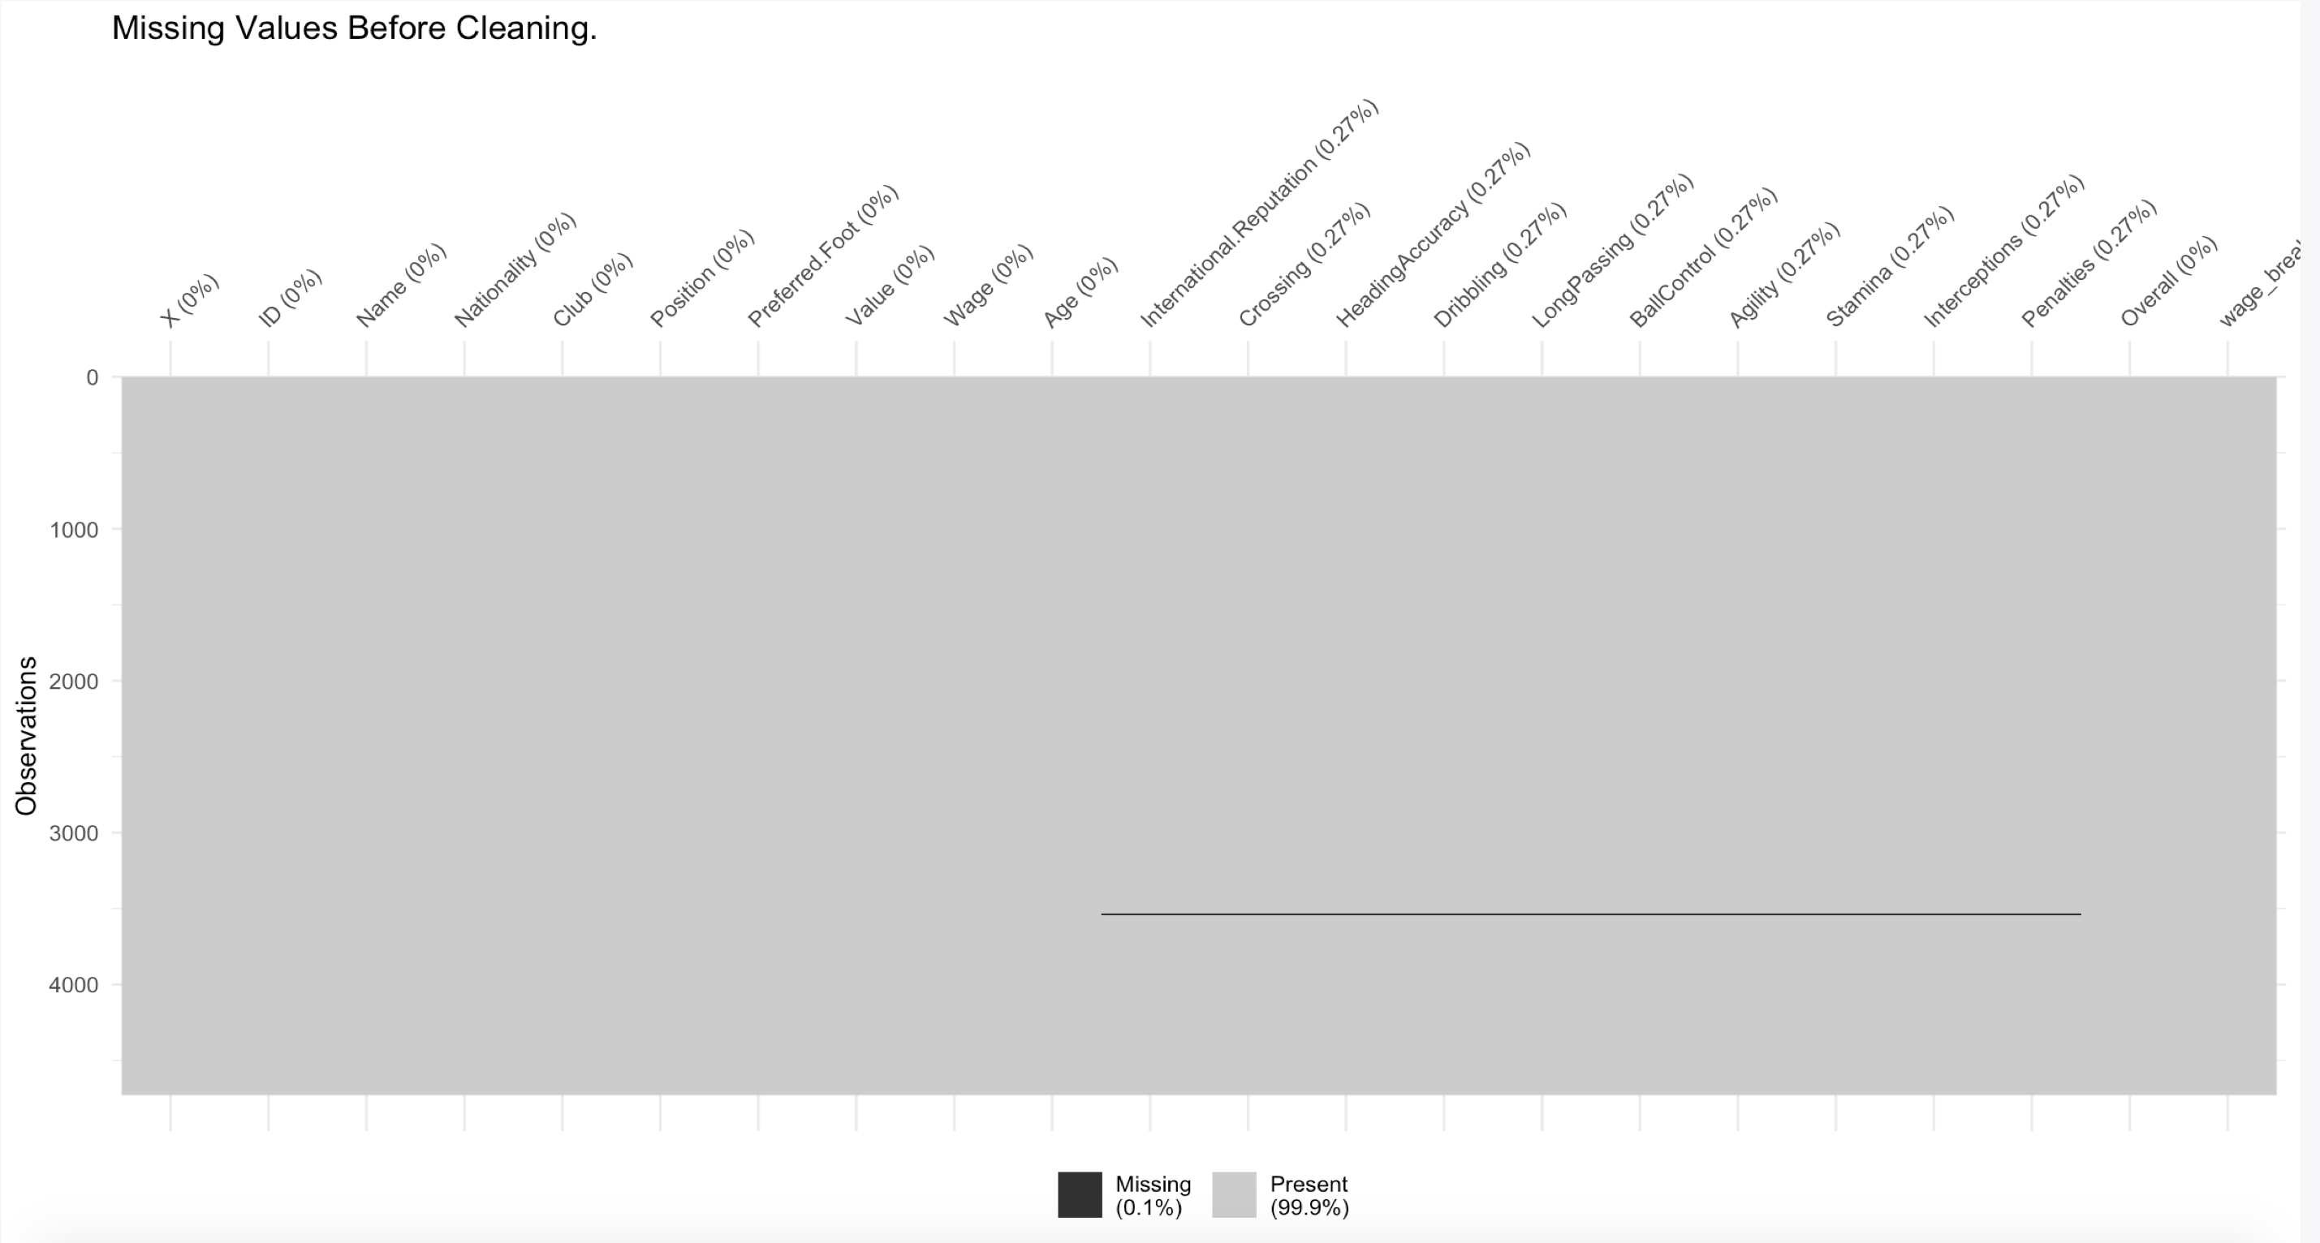
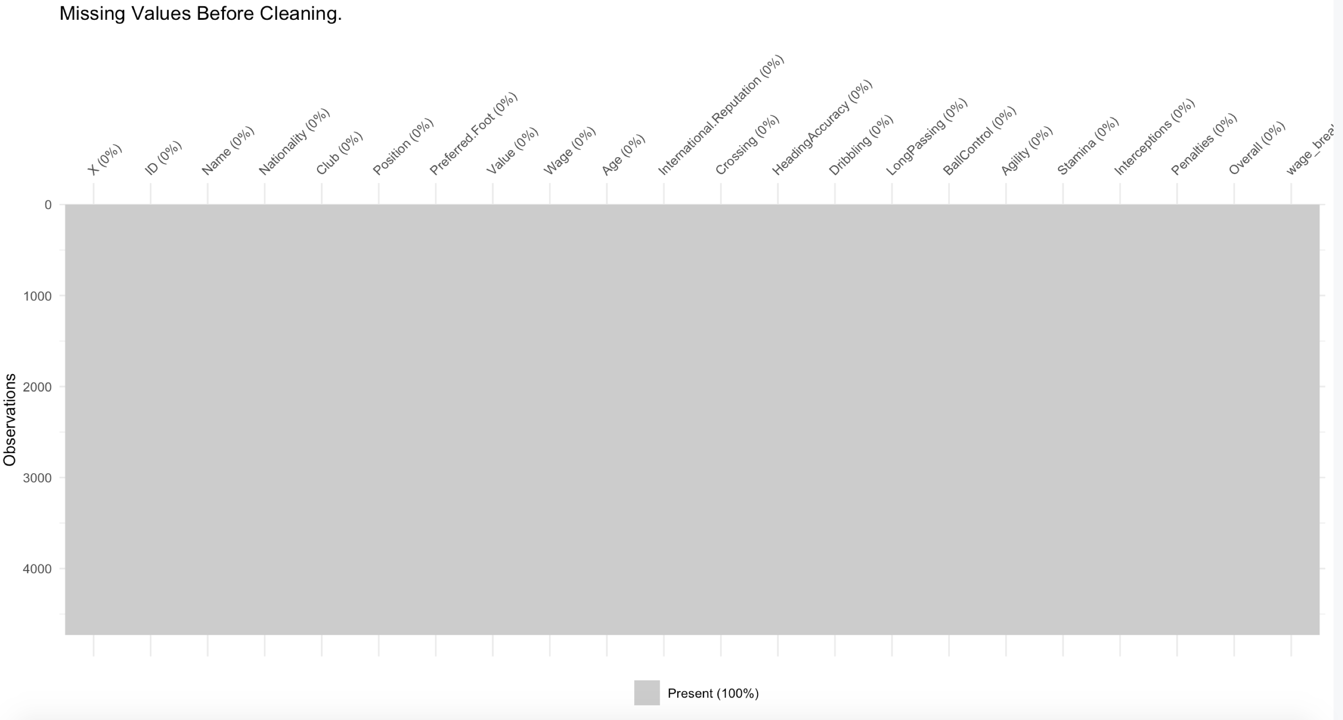
Missing Values

Slide 10
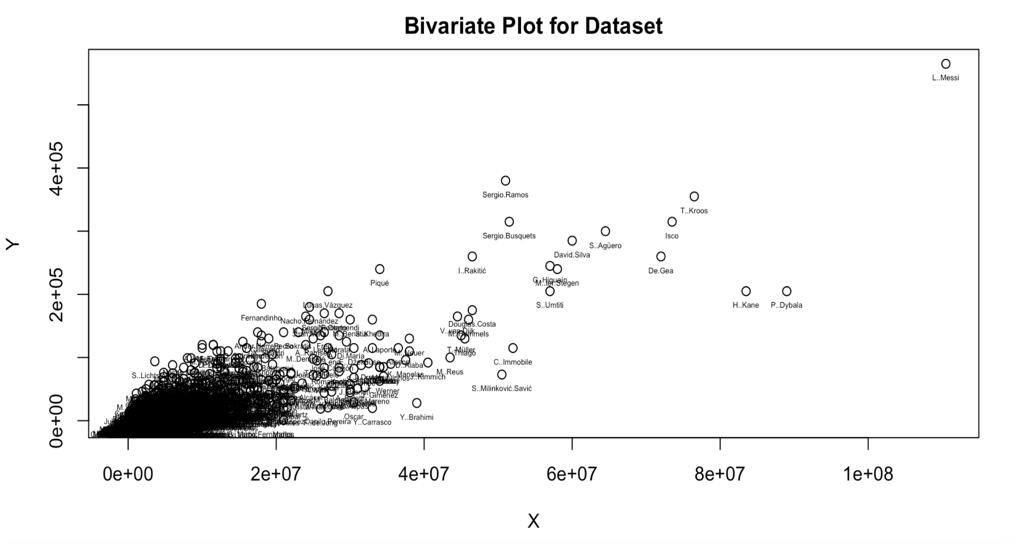
Bivariate Plot

Slide 11
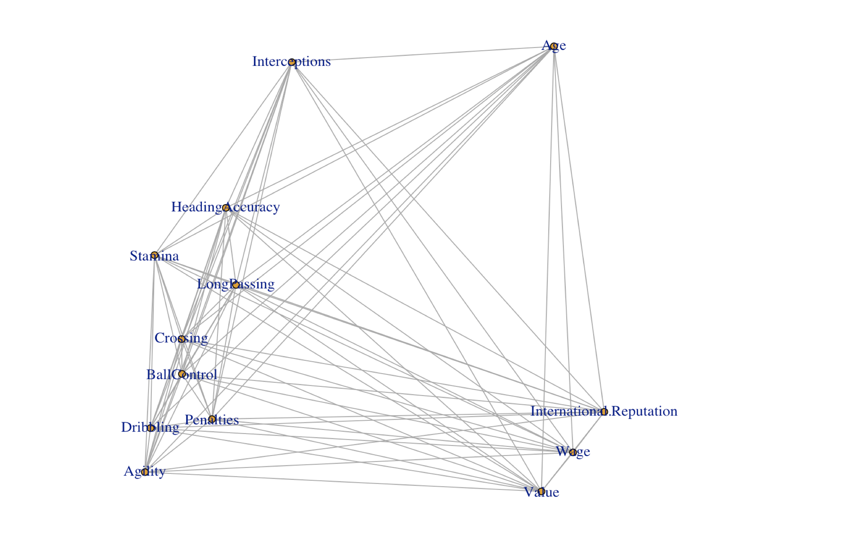
Dimension Reduction Analysis
Multi Dimensional Scaling
Canonical Correlation Analysis

Slide 12
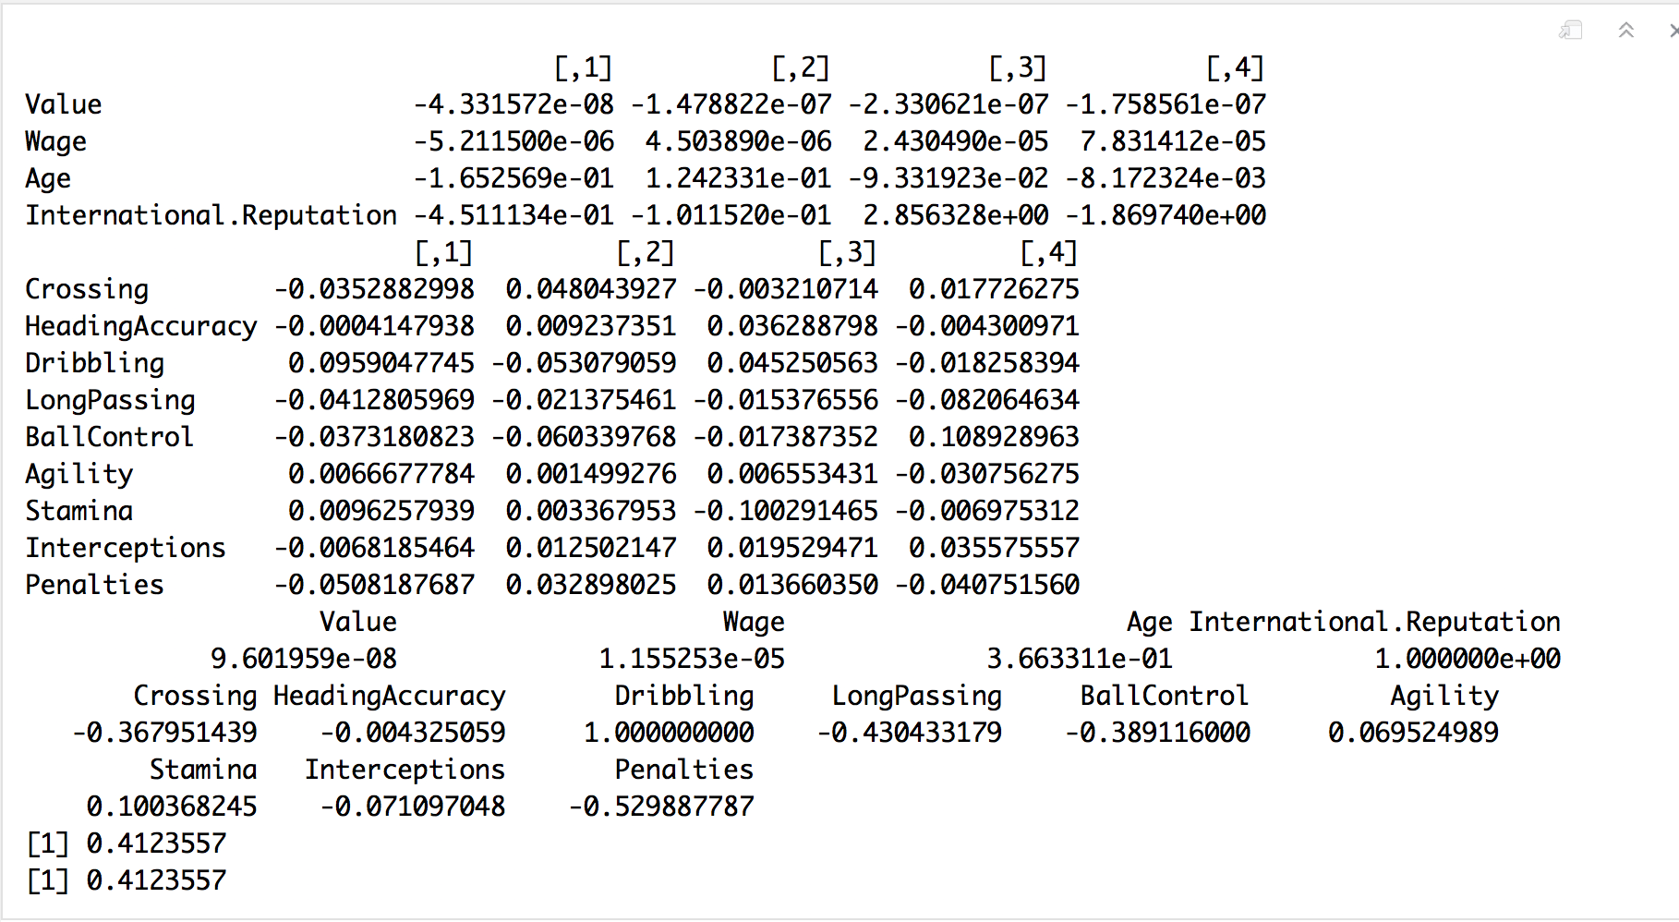
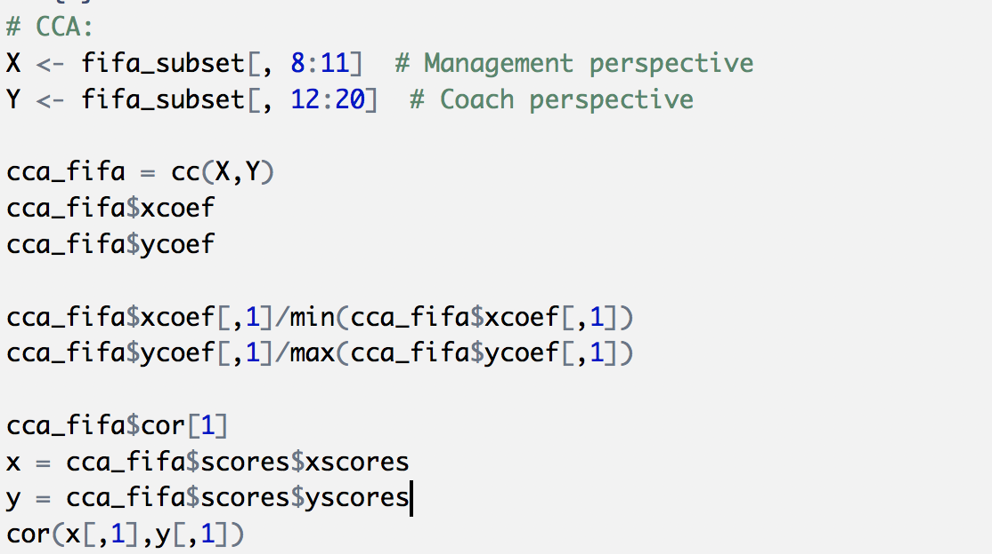
Continue…Canonical Correlation Analysis

Slide 13
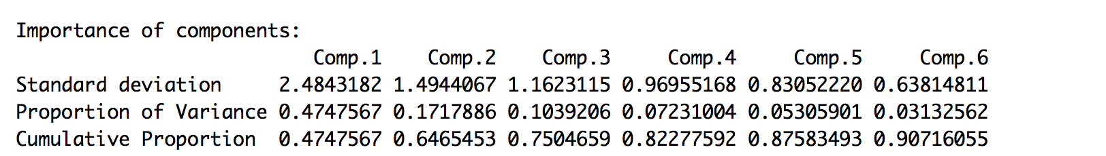
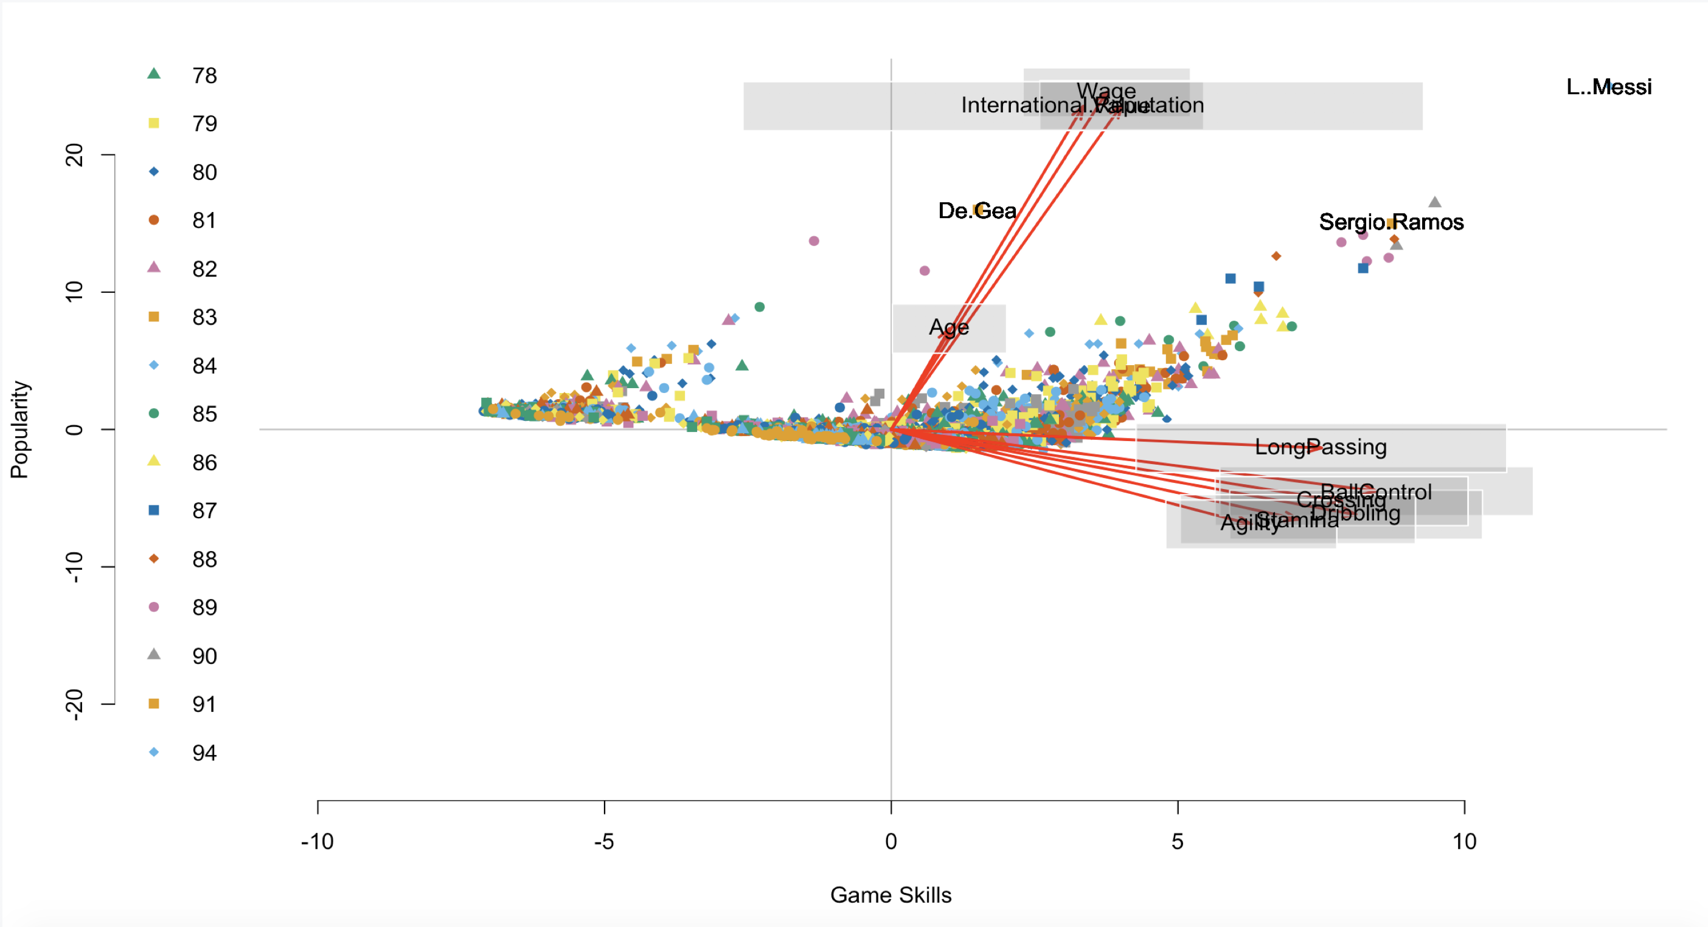
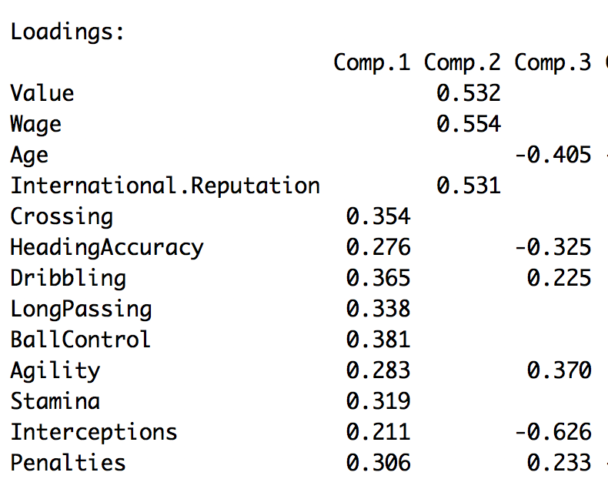
Dimension Reduction Analysis Principal Component Analysis(PCA) Exploratory Factor Analysis(EFA)

Slide 14
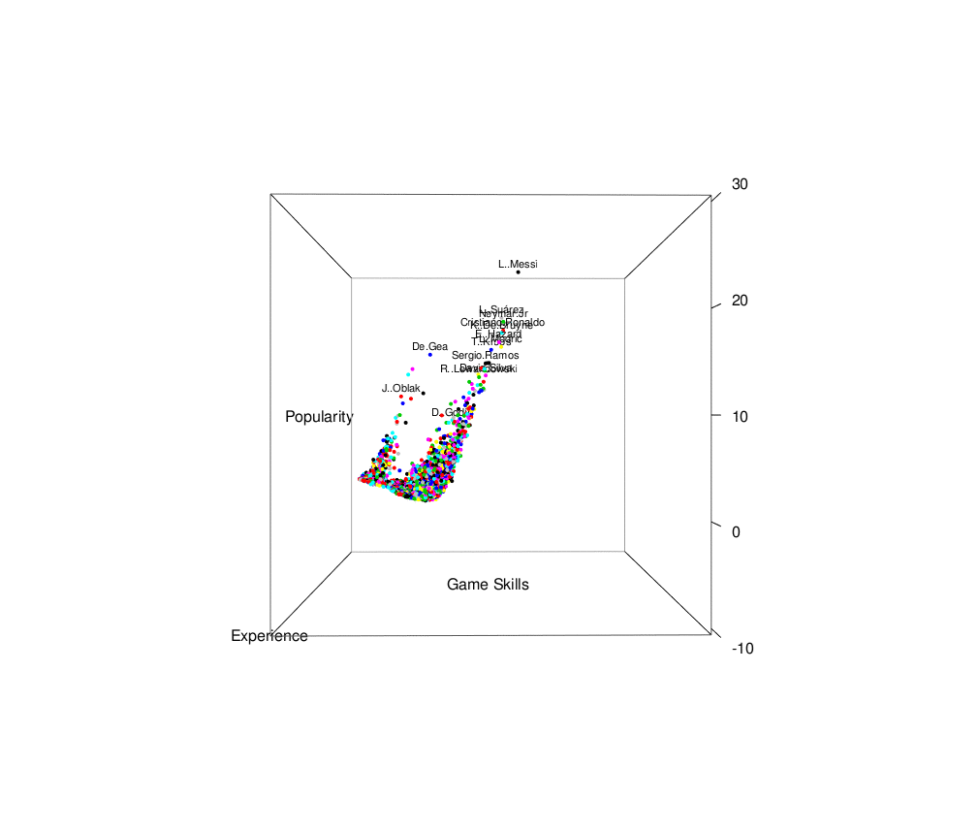
PCA Scores

Slide 15
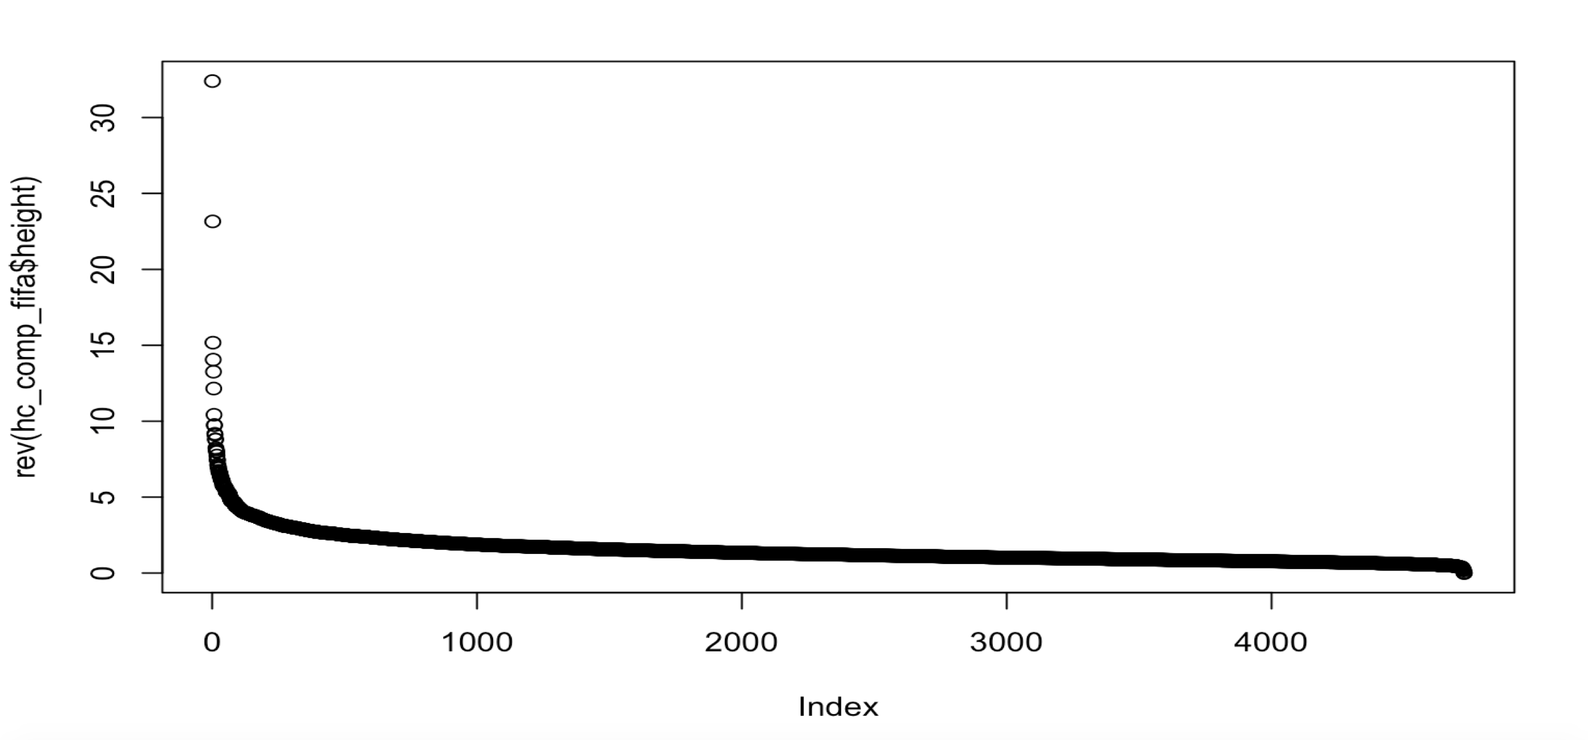
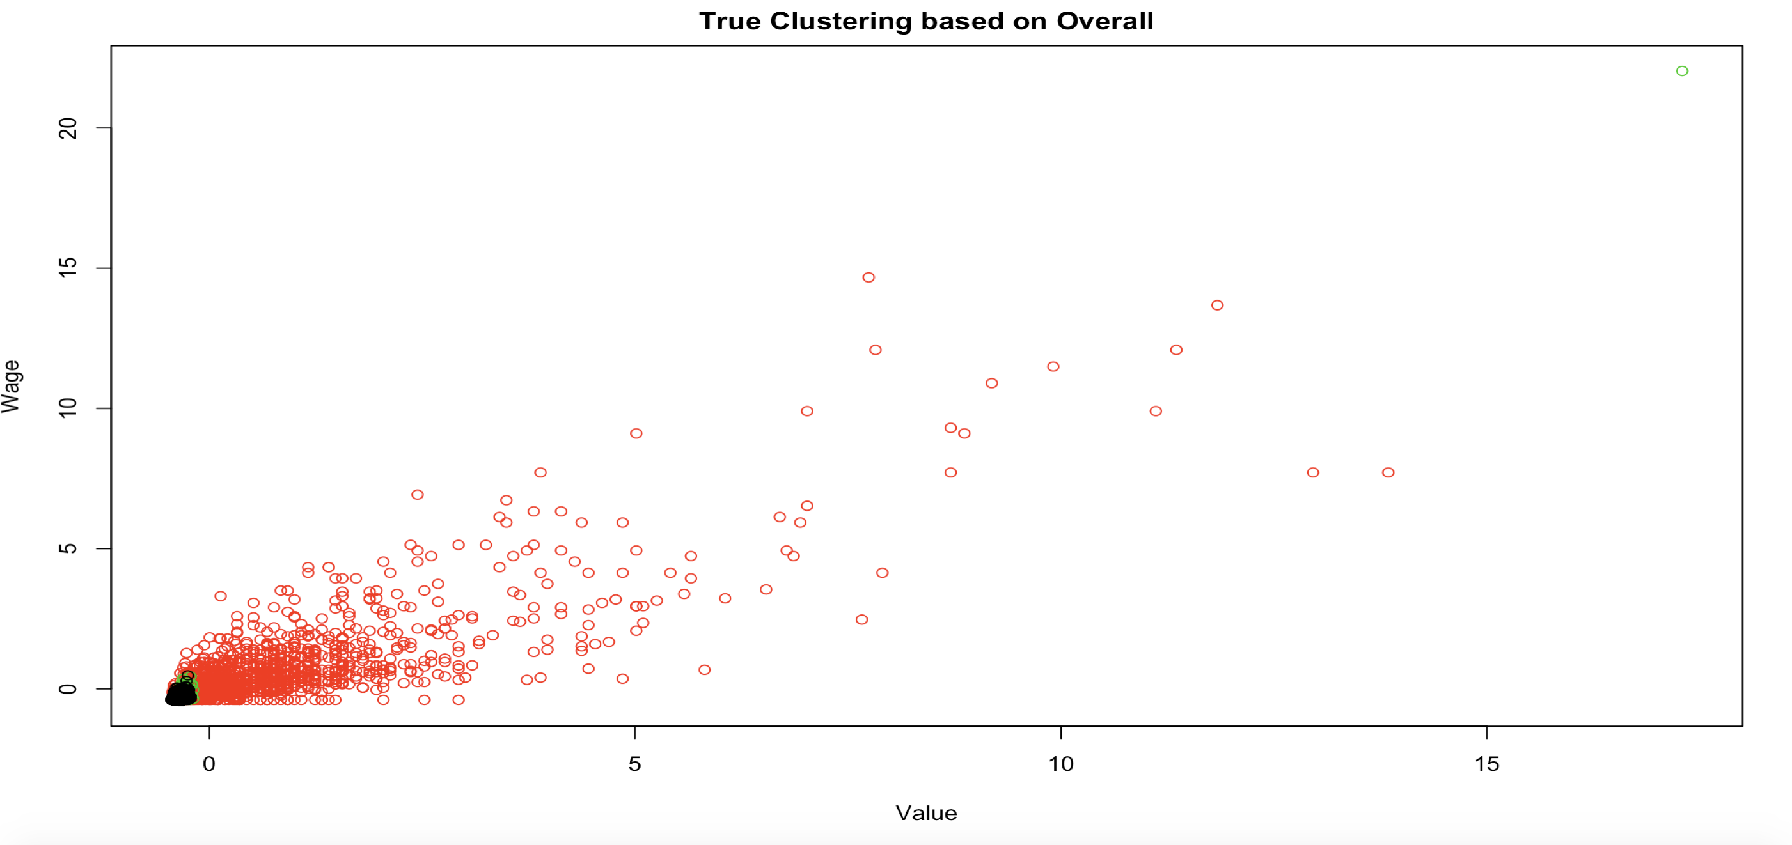
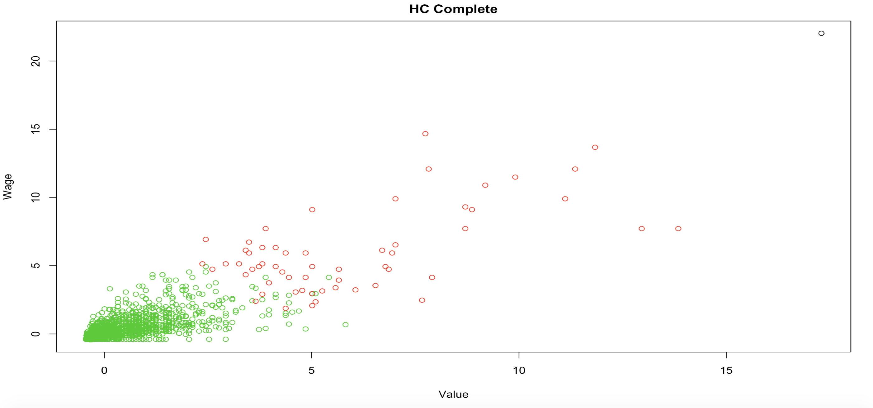
Cluster Analysis HC- Complete

Slide 16
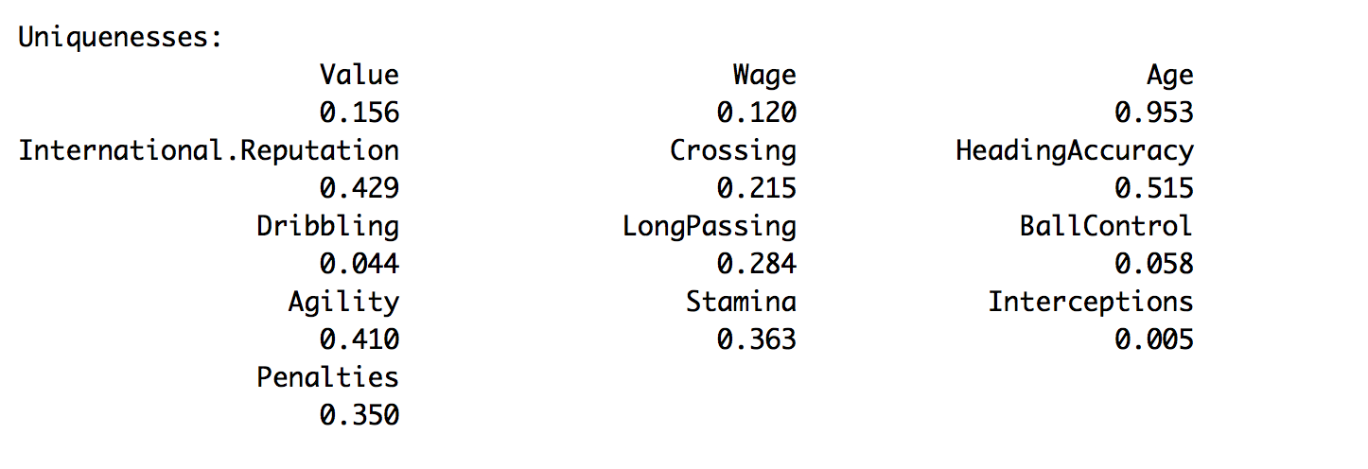
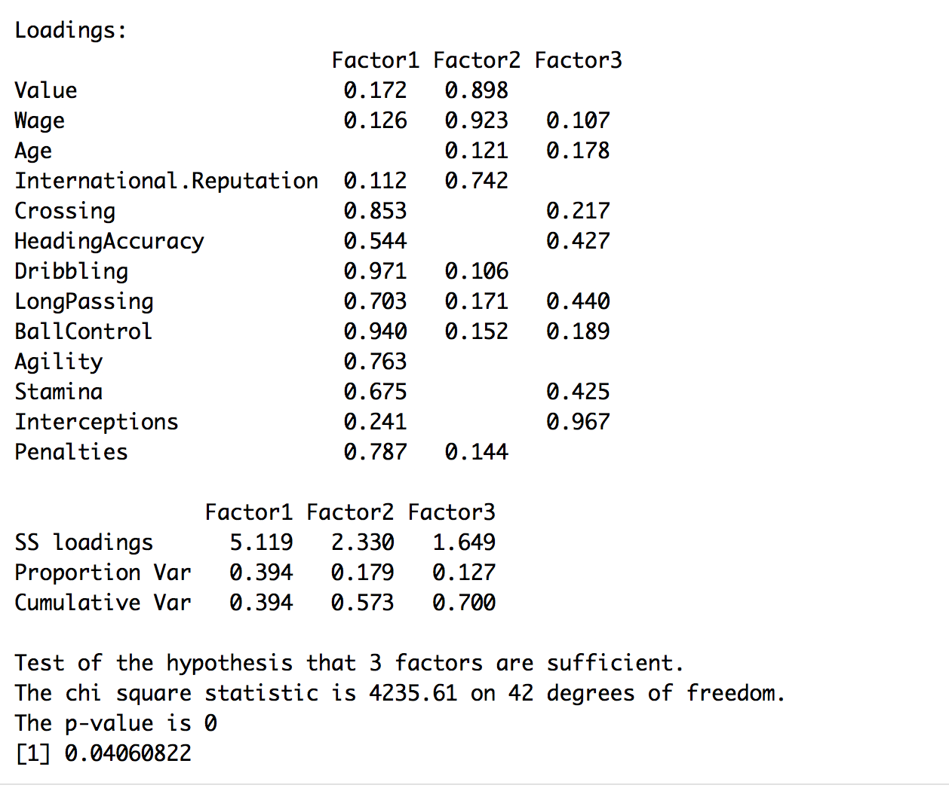
Factor Analysis EFA

Slide 17
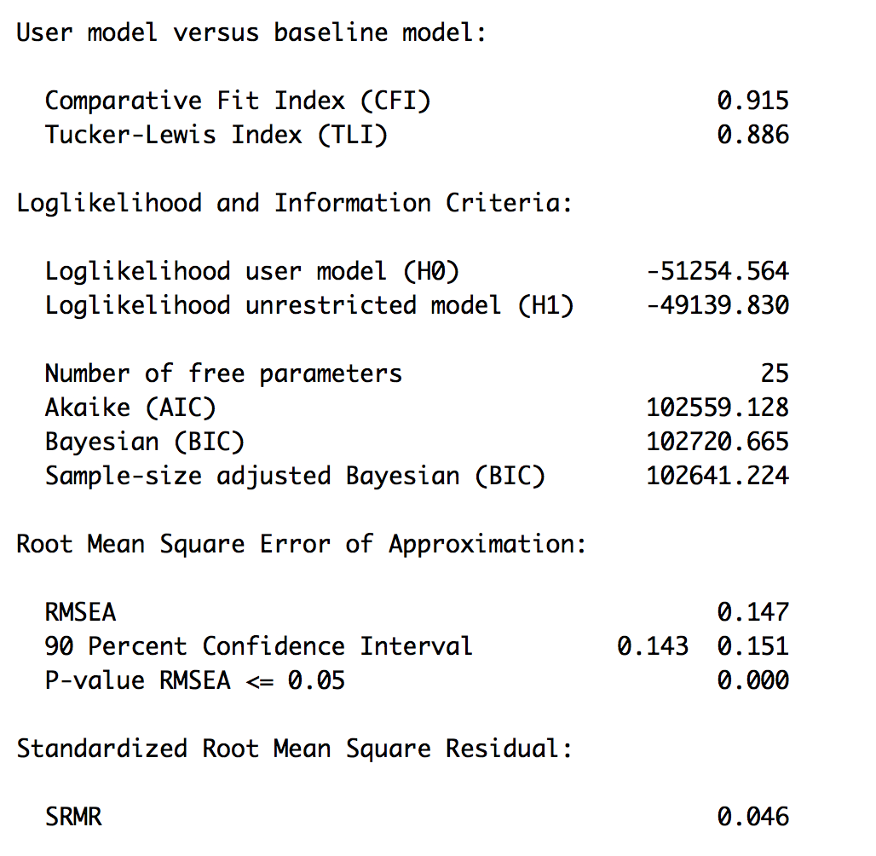
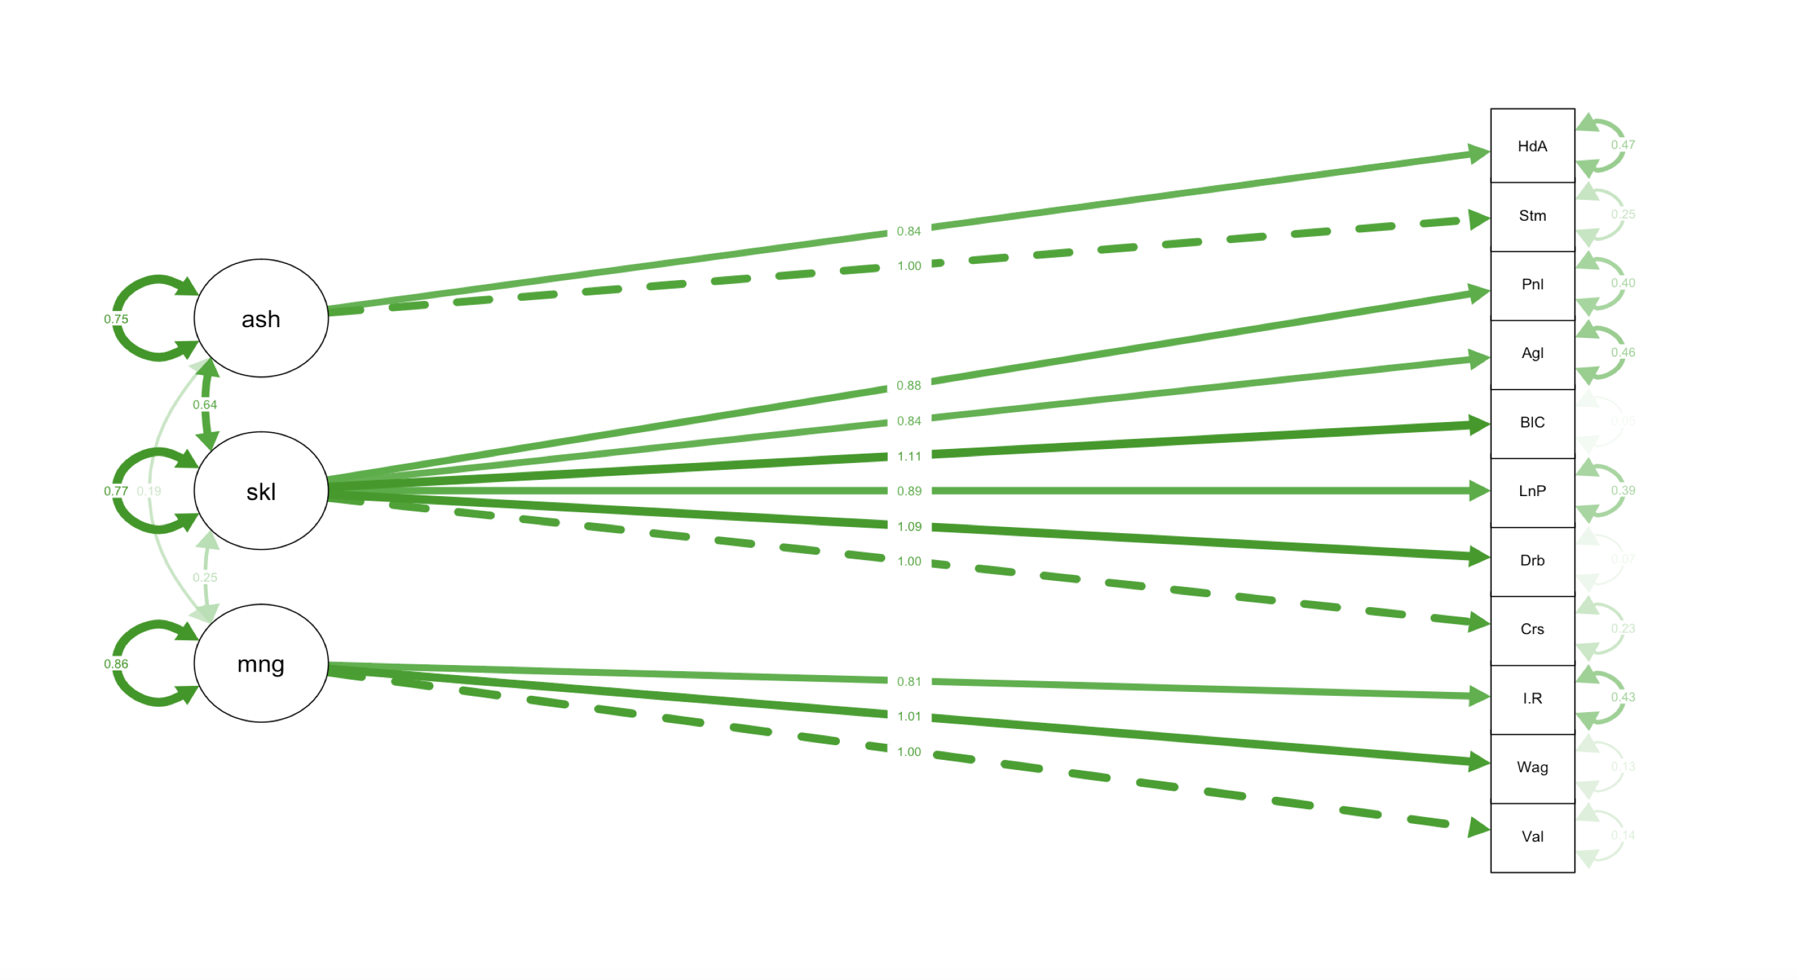
Confirmatory factor Analysis

Slide 18
Conclusion
Selection of Players based on position is future implementation
Management preferred players
Messi- Top performance, High wage
Kroos- Top performance, Low wage
De gea - Top performance Low wage.
Identified players by:
Game Skills
(Long Passing, Dribbling, Ball Control, Stamina)
Management Perspective
(Value, Wage, International Reputation)
Player Experience
(Age, Heading Accuracy, Interceptions)
Pros and Cons:
Able to identify the good players in the group based on clustering with appropriate factors
We didn’t consider the field position.

